Slide 1

DEPARTMENT OF COMPUTER SCIENCE AND ENGINEERING
ADVANCED MARINE DEBRIS DETECTION SYSTEM
BATCH YEAR : 2020 – 2024
SUPERVISOR : Asst. Prof. Dr.E.GANESH, M.E., Ph.D.
BATCH NO : 01
TEAM MEMBERS:
ABDUL HAFEEL H.A 110120104002
MOHAMED JAASIR A 110120104025
MOHAMED MUBEEN A.S 110120104028
MOHAMED NAFEES F 110120104029

Slide 2
ABSTRACT
Introduction to the global crisis of plastic pollution in oceans.
Proposal of an advanced marine debris detection system using deep learning.
Utilization of CNNs and ensemble learning for enhanced accuracy.
Integration of object detection via Clarifai API and user-friendly Voila app interface.
Contribution to environmental awareness and long-term solution for combating plastic pollution.

Slide 3
INTRODUCTION
Plastic pollution: A global crisis, with 30% of plastic production ending up in oceans.
Traditional methods for monitoring marine debris are costly and labor-intensive.
Proposal: Utilize deep learning techniques for accurate and scalable marine debris detection.
Aim: Develop efficient CNN models and enhance accuracy through ensemble learning.
Objectives: Evaluate model performance, estimate debris percentage, and create user-friendly interface for real-time detection.

Slide 4
LITERATURE SURVEY:
Automatic Detection and Identification of Floating Marine Debris Using Multispectral Satellite Imagery. Miguel M. Duarte and Leonardo Azevedo | 06 August 2019, Journal of geophysical research
We present an approach to detect and distinguish suspect plastic debris from other floating materials (i.e., driftwood, seaweed, sea snot, sea foam, and pumice) using Sentinel-2 data. We use extreme gradient boosting trained with data compiled from published works complemented by manual interpretation of satellite images Algorithms: eXtreme Gradient Boosting,

Slide 5
Deep-Feature-Based Approach to Marine Debris Classification Ivana Marin , Sasa Mladenovic , Sven Gotovac , Goran Zaharija | 18 June 2021, Journal of geophysical research
This paper focuses on evaluating the performance of six prominent deep convolutional neural networks (CNNs) as feature extractors for identifying and classifying underwater marine debris . The findings suggest that fine-tuning the feature extractor generally leads to improved model performance, albeit at a higher computational cost. Algorithms: VGG19, InceptionV3, ResNet50, Inception-ResNetV2, DenseNet121, and MobileNetV2.

Slide 6
Target Classification of Marine Debris Using Deep Learning Anum Aleem , Samabia Tehsin , Sumaira Kausar , Amina Jameel | 12 August 2021, Journal of geophysical research
The system reported in this paper uses a deep learning method to detect and classify debris in sonar images. The approach enhances image quality and reduces noise. To tackle limited data, it employed Faster R-CNN with ResNet-50 transfer learning. Algorithms: R-C NN , ResNet-50

Slide 7
Submerged marine debris detection with autonomous underwater vehicles Matias Valdenegro | December 2021, Journal of geophysical research
The paper proposes using Autonomous Underwater Vehicles (AUVs) equipped with Forward-Looking Sonar (FLS) and Convolutional Neural Networks (CNNs) to detect submerged marine debris in underwater environments. The unique challenges of underwater detection make traditional methods difficult, but this approach aims to overcome those obstacles Algorithms: CNN

Slide 8
Identifying floating plastic marine debris using a deep learning approach Kyriaki Kylili , Loannis Kyriakides , Alessandro Artusi , Constantinos Hadjistassou | 18 April 2019 , Journal of geophysical research
Introduces a new method to quickly and accurately identify floating plastic debris in oceans. Using deep learning, it can distinguish between different types of plastic like bottles, buckets, and straws with an 86% success rate. This approach offers a faster and more cost-effective way to assess the amount of floating plastics, addressing a crucial environmental concern Algorithms: CNN

Slide 9
EXISTING SYSTEM
Duarte and Azevedo's system utilizes multispectral satellite imagery from Sentinel-2 to detect and categorize floating marine debris, particularly plastic debris.
The method employs extreme gradient boosting trained on data gathered from published sources, along with manual interpretation of satellite images, resulting in an impressive 98% accuracy in identifying suspect plastic debris.
Despite its success, the approach has limitations, including the necessity for ground-truth validation, difficulty in detecting debris with mixed bands, and challenges associated with subpixel coverage of debris within a pixel.

Slide 10
PROPOSED SYSTEM
Aims to revolutionize marine debris monitoring using advanced deep learning and computer vision.
Statistical Evaluation: Evaluation using precision, recall, F1-score, and confusion matrix. Comparative analysis to optimize model performance.
Utilizes Clarifai API for accurate object detection in ocean images.
User-friendly interface for easy interaction and real-time results.
Scalable Solution: Suitable for global monitoring of plastic pollution.
High Detection Accuracy: Reduces false positives and false negatives.
Percentage Estimation: Provides insights into plastic pollution extent.

Slide 11
COMPARISON:
Features | Existing System | Proposed System
Data Source | Multispectral satellite imagery (Sentinel-2) | Multispectral satellite imagery (Sentinel-2) and labelled image dataset
Methodology | Extreme gradient boosting | Convolutional neural network (CNN) models with ensemble learning techniques
Accuracy | Achieves 98% accuracy rate | Almost 100% accuracy in detection and further improvements in object classification
Validation Requirement | Requires ground-truth validation | Utilizes statistical evaluation with metrics such as precision, recall, F1-score, and confusion matrix
Detection Efficiency | Faces challenges due to mixed band nature of the sensor and subpixel coverage | Implements algorithms for efficient detection, quantification, and percentage estimation
Scalability and Real-time Monitoring | Limited scalability and real-time monitoring | Provides a scalable, cost-effective, and real-time solution for monitoring marine debris

Slide 12
METHODOLOGY:
Dataset Creation: Collected data by web surfing to create a dataset for marine debris detection.
Model Selection: Experimented with three different models:
Simple Convolutional Neural Network (CNN)
Random Forest
Ensemble of Simple CNN and Random Forest
Evaluation Metrics: After training the models, evaluated their performance using accuracy and F1 score metrics.
Verification: To add further verification and confidence to the findings, we utilized a paired permutation test. This test helps in assessing the statistical significance of the observed performance difference between the models.

Slide 13
EVALUATION METRICS FORMULAS:
Accuracy = (TP + TN)/(TP + TN + FP + FN)
Precision = TP/(TP + FP)
Recall = TP/(TP + FN)
F1-Score = 2 * (Precision * Recall) / (Precision + Recall)

Slide 14
ALGORITHM EXPLANATION:
1. Simple Convolutional Neural Network (CNN):
Data Preprocessing : The dataset of marine environment images is collected and preprocessed. Preprocessing techniques such as resizing, normalization, and data augmentation are applied to ensure uniformity and increase variability.
Model Architecture : A CNN model with convolutional and max-pooling layers is constructed to efficiently extract features from the images. Dropout layers are employed to mitigate overfitting and improve generalization . The architecture is finalized with a softmax layer for multi-class classification, distinguishing between debris and non-debris classes.
Training and Evaluation : The CNN model is trained using the training set, optimizing hyperparameters like learning rate and batch size based on performance on the validation set . The trained model is evaluated on the test set to assess its generalization ability, measuring metrics like accuracy, precision, recall, and F1-score.

Slide 15
2. Random Forest (RF):
Data Preparation : A diverse dataset of marine environment images containing debris-laden scenes and debris-free ones is assembled, ensuring it covers various debris types and environmental conditions. Relevant features such as color histograms or texture features are extracted from these images.
Model Training : The Random Forest classifier is trained on the extracted features from the training data. Different hyperparameters like the number of trees and tree depth are experimented with to optimize performance while avoiding overfitting.
Evaluation : The trained Random Forest model is validated using the validation set, adjusting hyperparameters based on performance metrics like accuracy, precision, recall, and F1-score. The model is evaluated on the test set to assess its performance on unseen data.
3. Simple CNN + Random Forest Ensemble:
Data Preparation : Similar to the individual models, a comprehensive dataset of marine environment images is gathered and preprocessed

Slide 16
CNN Model Training : A CNN model is built for feature extraction and representation learning. The model is trained on the training dataset and optimized using the validation set. Features are extracted from the last convolutional layer of the trained CNN model for each image in the dataset.
Random Forest Model Training : A Random Forest classifier is constructed using the extracted features as input. The model is trained on the training set, fine-tuning hyperparameters using cross-validation on the validation set.
Ensemble Creation : The predictions of the CNN and Random Forest models are combined to create an ensemble. This can be done by averaging their predicted probabilities or using a weighted average based on their performance. Alternatively, the output of the CNN can be used as additional features for the Random Forest classifier.
Evaluation : The ensemble model is evaluated on the test set to measure its performance in marine debris detection.
4. Object Detection Using Clarifai API:
Initialization : The Clarifai API is initialized using the Clarifai Python client library and a Personal Access Token (PAT) for authentication.
Detection Process : An image is selected for object detection, and its URL is passed to the initialized model. The model predicts the objects present in the image and returns the results.
Visualization : The detected objects are visualized by drawing bounding boxes around them on the original image using the Matplotlib library.

Slide 17
5 . Voila App Development:
User Interface Development : A Voila app is developed to provide a user-friendly graphical interface for the Clarifai object detection model. The app allows users to upload images and receive real-time object detection results without needing to write any code.
Interactivity : Users can interact with the model through the graphical interface, making it easier to understand and utilize its capabilities. The app enhances the usability of the object detection model, making it accessible to a wider audience.

Slide 18
ALGORITHMS COMPARISON:
Model | Accuracy | F1 Score | Type
CNN | 89.58% | 0.44 | Basic
RF | 84.37% | 0.84 | Homogeneous Ensemble
CNN + RF | 100% | 1.0 | Heterogeneous Ensemble

Slide 19
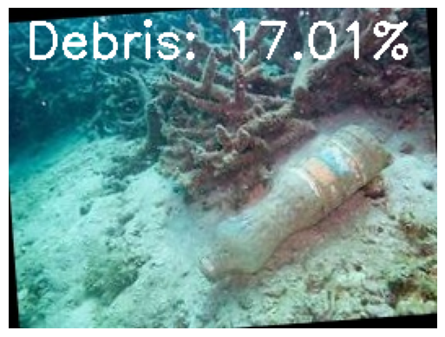
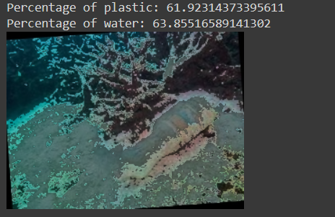
Results :
Percentage of Debris :

Slide 20
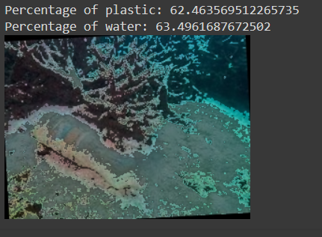
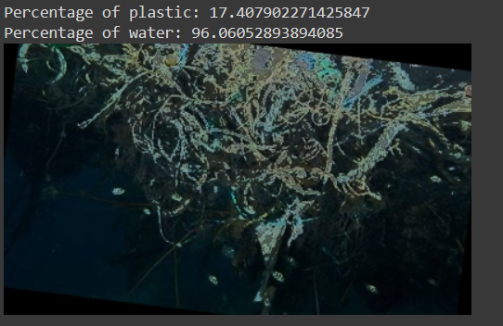

Slide 21
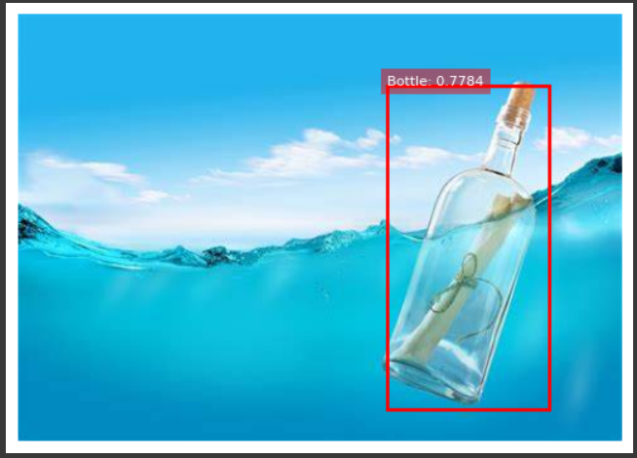
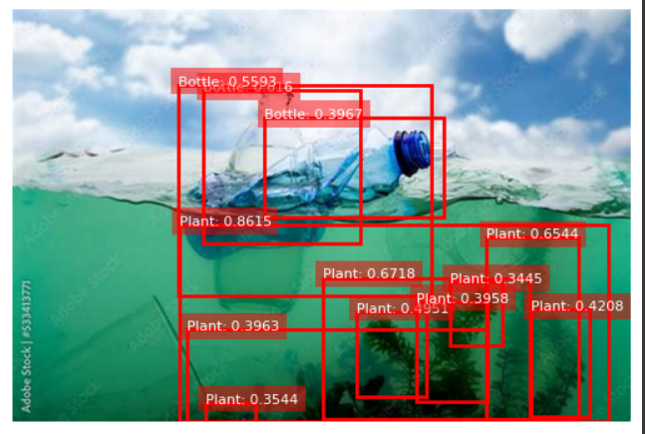
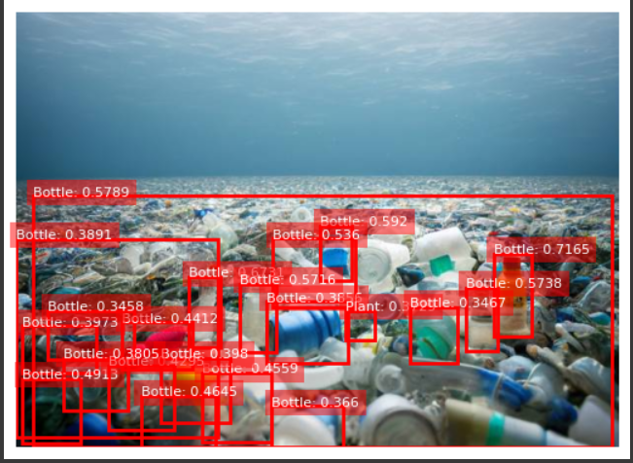
Object Detection using Clarifai :

Slide 22
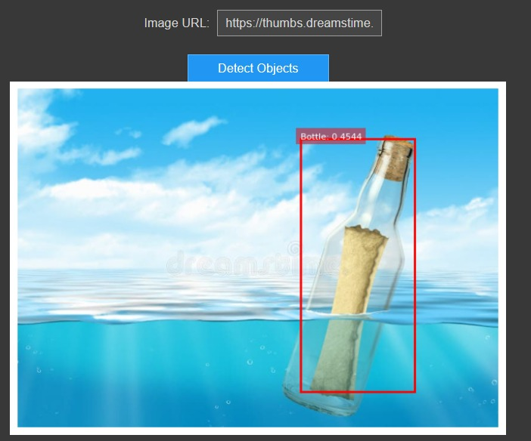
Voila App Output:

Slide 23
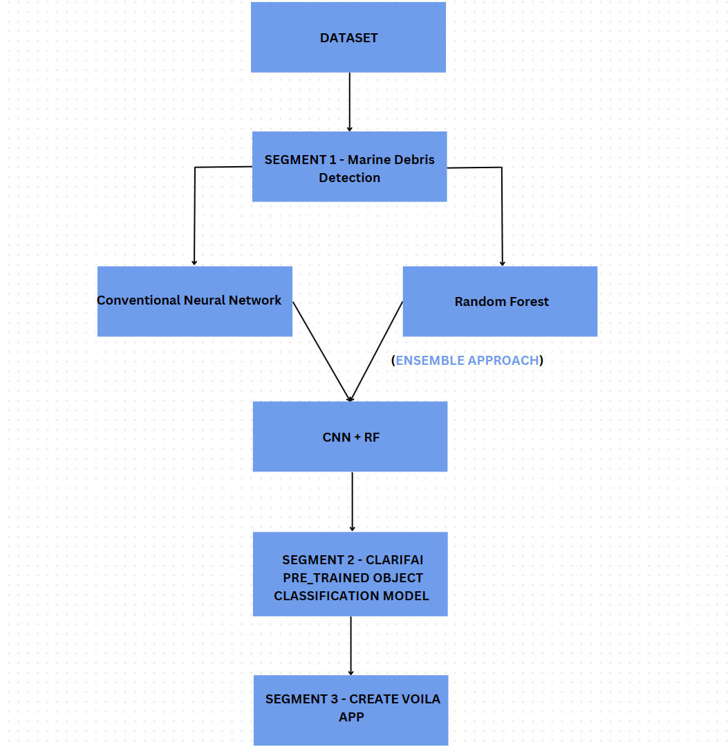
System Architecture Diagram :

Slide 24
FRAMEWORKS & LIBRARIES
Tensor Flow - The deep learning model for detecting marine debris
Keras - Keras acts as an interface for the TensorFlow Library
Pandas - a fast, flexible and easy to use open source data analysis and manipulation tool
Clarifai API - a powerful tool for image recognition and object detection
Matplotlib - comprehensive library for creating static, animated, and interactive visualizations
Scikit Learn - It features various classification, regression and clustering algorithms
Voila - a Jupyter extension that converts notebooks into interactive web applications

Slide 25
Conclusion :
Urgency of Plastic Pollution: Urgent attention required for the critical environmental issue of plastic pollution in oceans, with over 8 million tons entering annually.
Innovative Solution: Developed a novel marine debris detection system using deep learning and advanced computer vision techniques.
Robust System: Leveraged CNNs, random forest classifiers, and ensemble learning for accurate detection and classification of marine debris.
Demonstrated Effectiveness: Extensive testing and statistical analysis showcased high precision and recall in accurately identifying marine debris, achieving a remarkable accuracy of almost 100% and an F1 score of 1.0.
Enhanced Usability: Integration of Clarifai API for real-time object detection and user-friendly Voila app improve system accessibility and usability.
Contribution to Conservation: System contributes to environmental conservation efforts and promotes long-term solutions for preserving marine ecosystems.

Slide 26
REFERENCES
[1] Marin, I., Mladenović, S., Gotovac, S., & Zaharija, G. (2021). Deep-feature-based approach to marine debris classification. Applied Sciences, 11(12), 5644.
[2] Aleem, A., Tehsin, S., Kausar, S., & Jameel, A. (2022). Target Classification of Marine Debris Using Deep Learning. Intelligent Automation & Soft Computing, 32(1).
[3] Valdenegro-Toro, M. (2016, December). Submerged marine debris detection with autonomous underwater vehicles. In 2016 International Conference on Robotics and Automation for Humanitarian Applications (RAHA) (pp. 1-7). IEEE.
[4] Kylili, K., Kyriakides, I., Artusi, A., & Hadjistassou, C. (2019). Identifying floating plastic marine debris using a deep learning approach. Environmental Science and Pollution Research, 26, 17091-17099.
[5] Goodfellow, I., Bengio, Y., & Courville, A. (2016). "Deep Learning". MIT Press.
[6] Shanmugamani, R. (2019). "Deep Learning for Computer Vision". Packt Publishing.
[7] Géron, A. (2019). "Hands-On Machine Learning with Scikit-Learn, Keras, and TensorFlow". O'Reilly Media.

Slide 27
THANK YOU

